Slide 1






PowerShell Conference Asia
DSC Resources for VMware vSphere
DSC for “foreign” environments

Slide 2
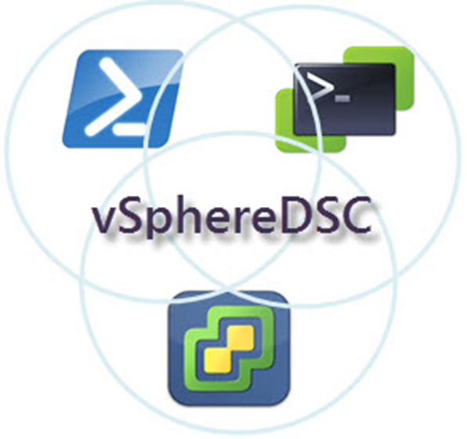

Agenda
A bit of history
Concept
Choices
Pitfalls
Module organization
Birdseye
Close Up
Reverse
PowerShell Conference
Singapore 2017

Slide 3
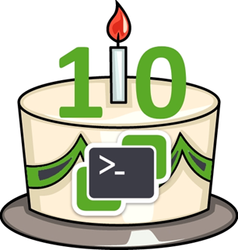
History
SDDC: one way is DSC
PowerCLI is my tool of choice
PowerShell
VMworld 2015
First public repo GitHub
PowerShell v5 (Feb 2016)
Hackathons VMworld 2016
PowerShell v5.1 (Jan 2017)
PowerCLI v6.5.2 (Aug 2017) – PSGallery
Ideas/Suggestions: https://powercli.ideas.aha.io/
PowerShell Conference
Singapore 2017

Slide 4
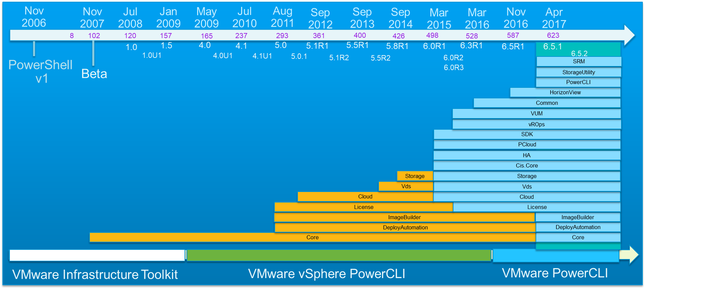
Some more history
PowerShell Conference
Singapore 2017

Slide 5
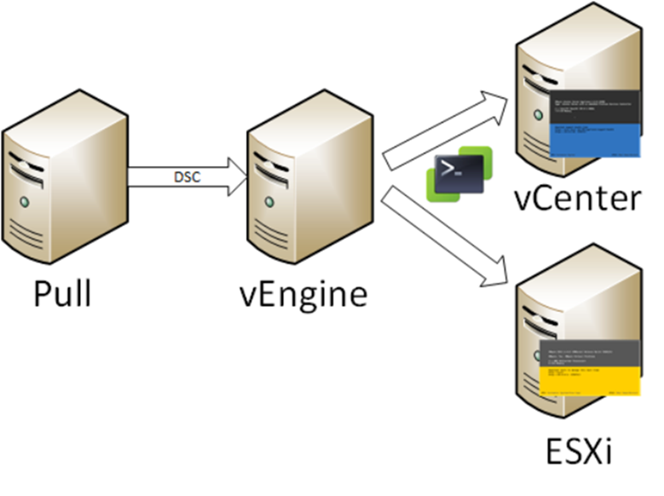
Concept
vSphere Servers: closed box
vCenter (VCSA)
ESXi node
vEngine
Runs the LCM
PowerCLI installed
Connects to target vSphere Server
PowerShell Conference
Singapore 2017

Slide 6
Choices
vEngine currently a Windows (W2K16) box
Secure environment (AllSigned)
Classes
Inheritance
MOF
All vSphere code uses API directly
Faster
Covers features not available in PowerCLI cmdlets (80%-20% rule)
PowerShell Conference
Singapore 2017

Slide 7


Pitfalls – PowerCLI - Security
Pre PowerCLI 6.5R1
PSSnapins
No autoload available
Using module & RequiredAssemblies ⬅ Vmware.Vim types
LCM fails at MOF generation
PowerCLI code in “helper” file (again!)
Security
Certificates
Code signing
Credential encryption
PowerShell Conference
Singapore 2017

Slide 8
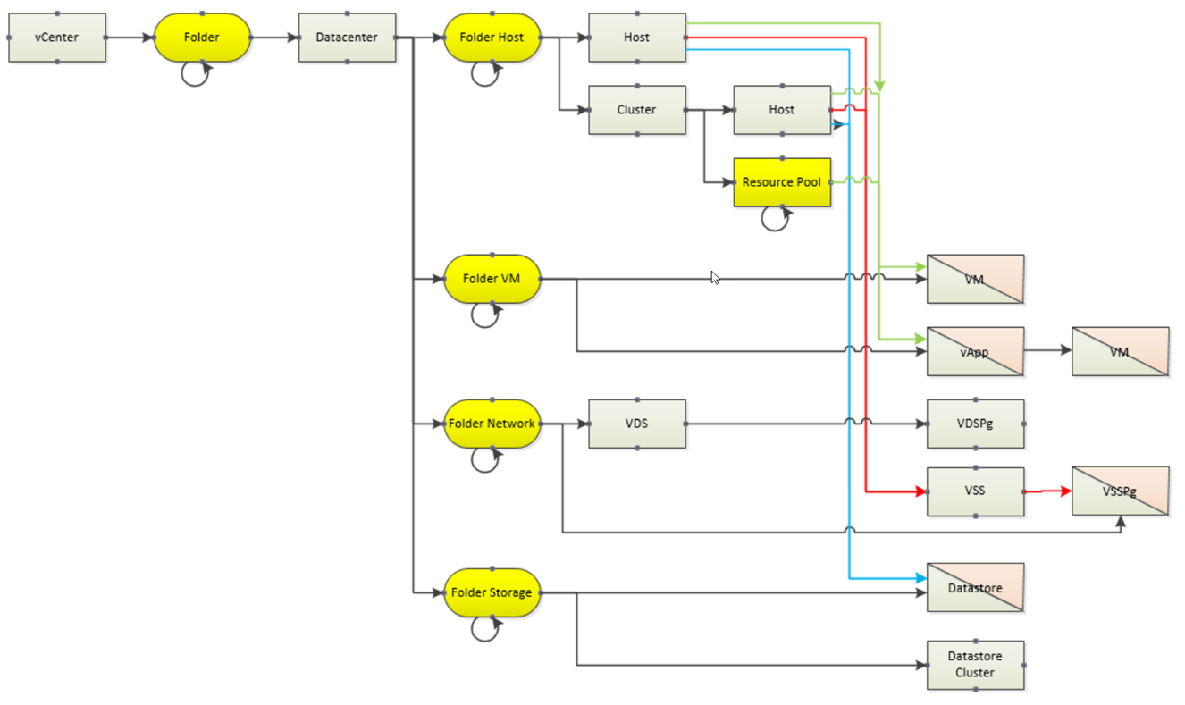
Pitfalls – Legacy Code
Legacy
VSS under Host
VDS in Network Folder
Hidden Folders
Datacenters, Hosts, VM…
Dual homed objects
VM
Datastore
PowerShell Conference
Singapore 2017

Slide 9
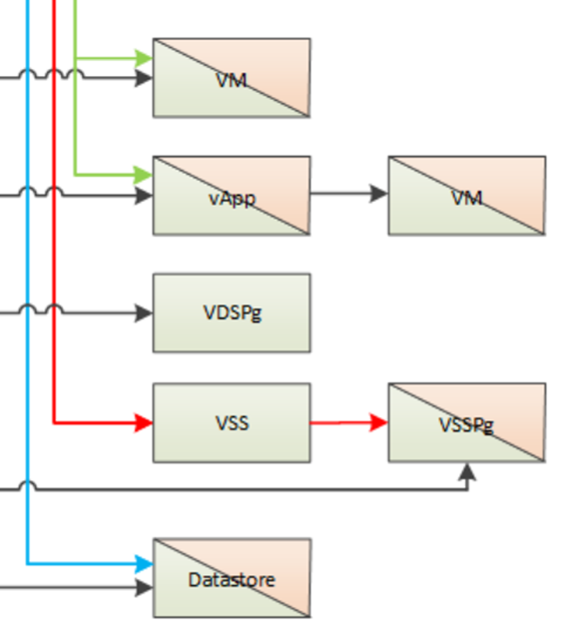
Pitfalls – Addressing an Object
How to uniquely address a vSphere object
Common = VmwBase class
Name (e.g. Folder1)
Path (e.g. /DC1/Folder1)
Several objects have more than 1 path
PowerShell Conference
Singapore 2017

Slide 10
Choices
PowerShell Conference
Singapore 2017

Slide 11
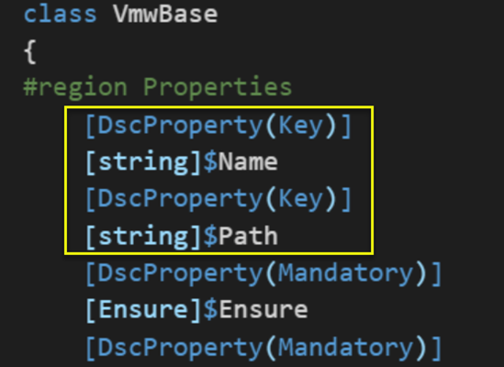

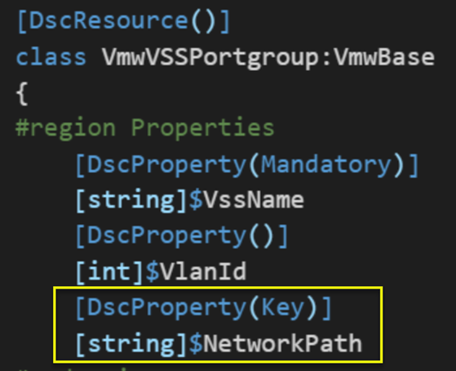
Classes FTW
Base object = Base class
Specifics in derived class
PowerShell Conference
Singapore 2017

Slide 12
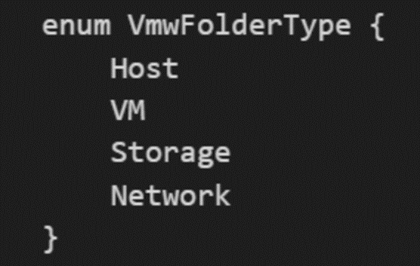
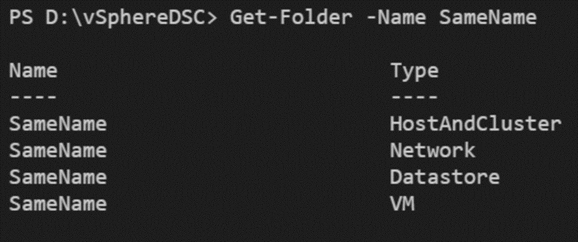
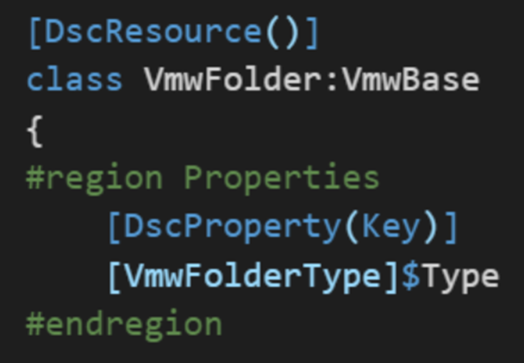
Name Collision
PowerShell Conference
Singapore 2017

Slide 13
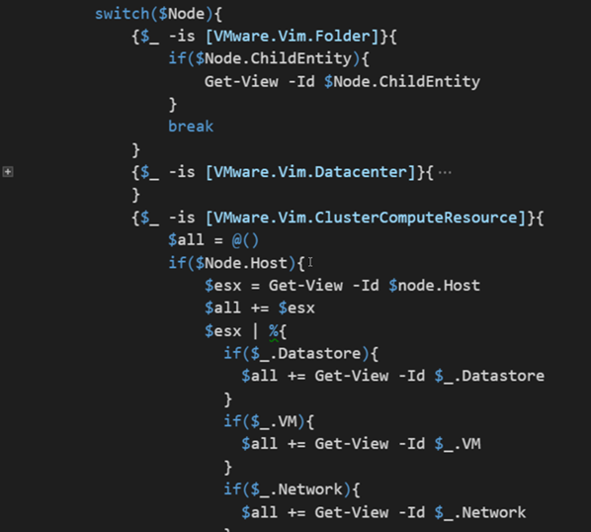
The vSphere Tree
Traversing the vSphere tree
Legacy structure
“Parent” property absent for some
PowerShell Conference
Singapore 2017

Slide 14
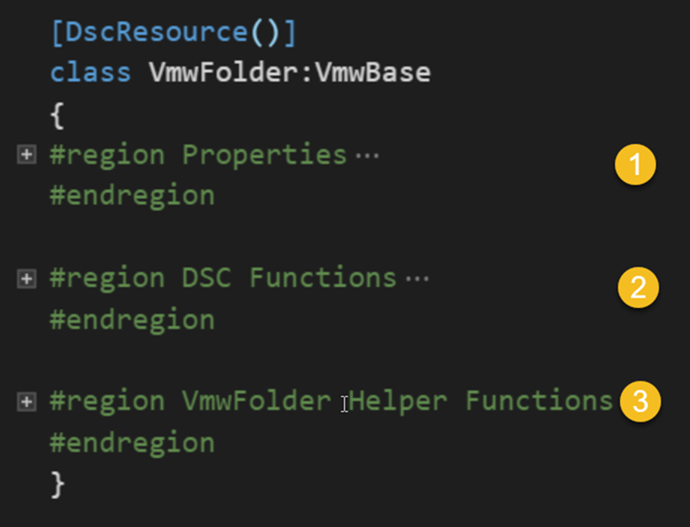
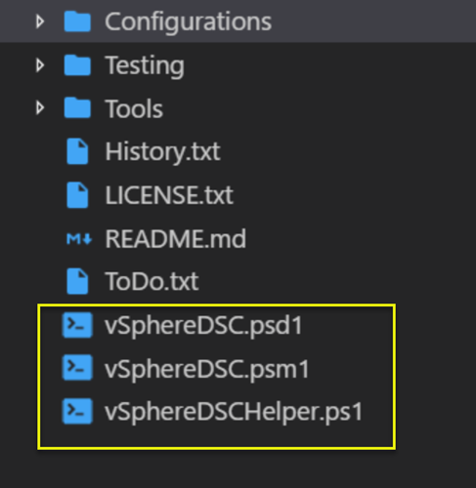
High Level and some Concepts
Simple, “clean” structure
Each resource, same layout
PowerShell Conference
Singapore 2017

Slide 15
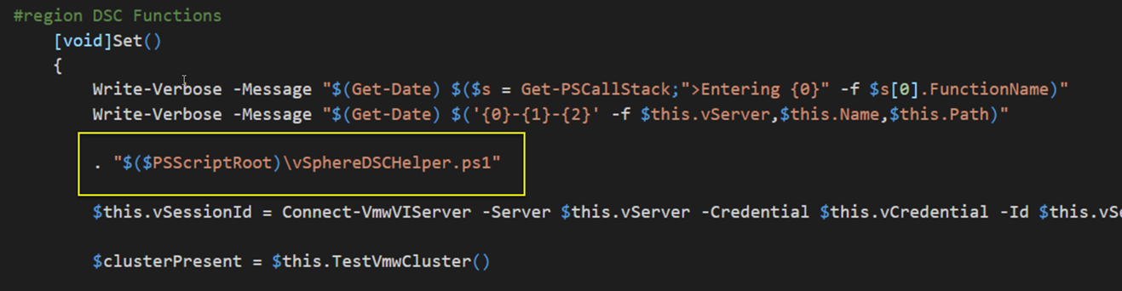
Dot Sourcing
Separate PS and PowerCLI code (Vmware.Vim types!)
All PowerCLI code in vSphereDSCHelper.ps1
Dot-source
Not elegant, but it works!
PowerShell Conference
Singapore 2017

Slide 16
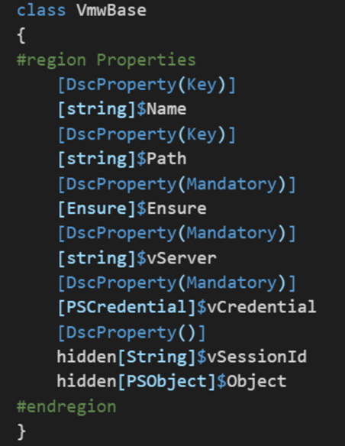
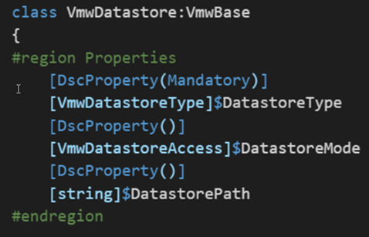
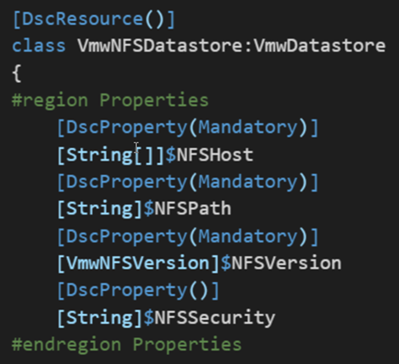
Classes and Inheritance
Properties
Classes + inheritance
PowerShell Conference
Singapore 2017

Slide 17
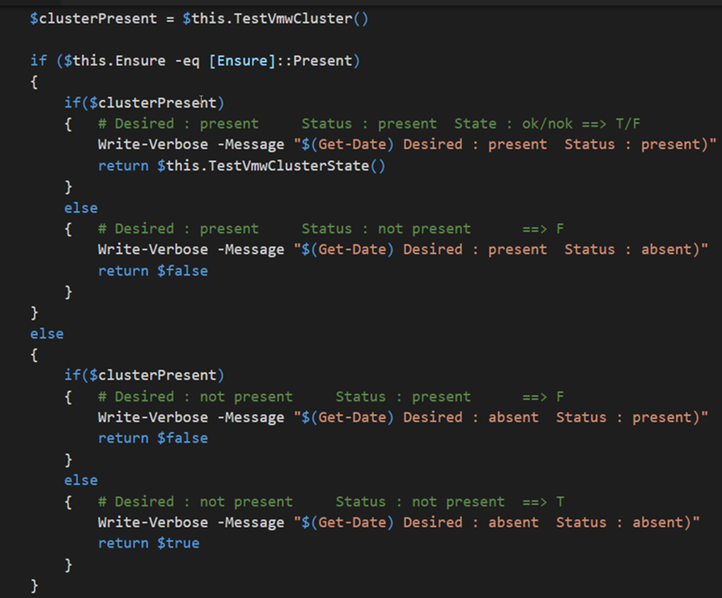
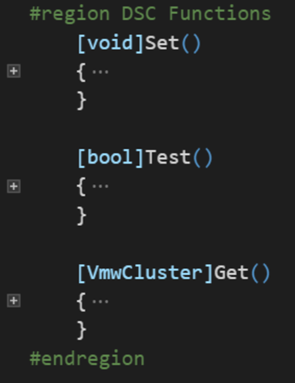
DSC Logic
Test/Set/Get: only the logic
No PowerCLI!
State of an Object!
PowerShell Conference
Singapore 2017

Slide 18
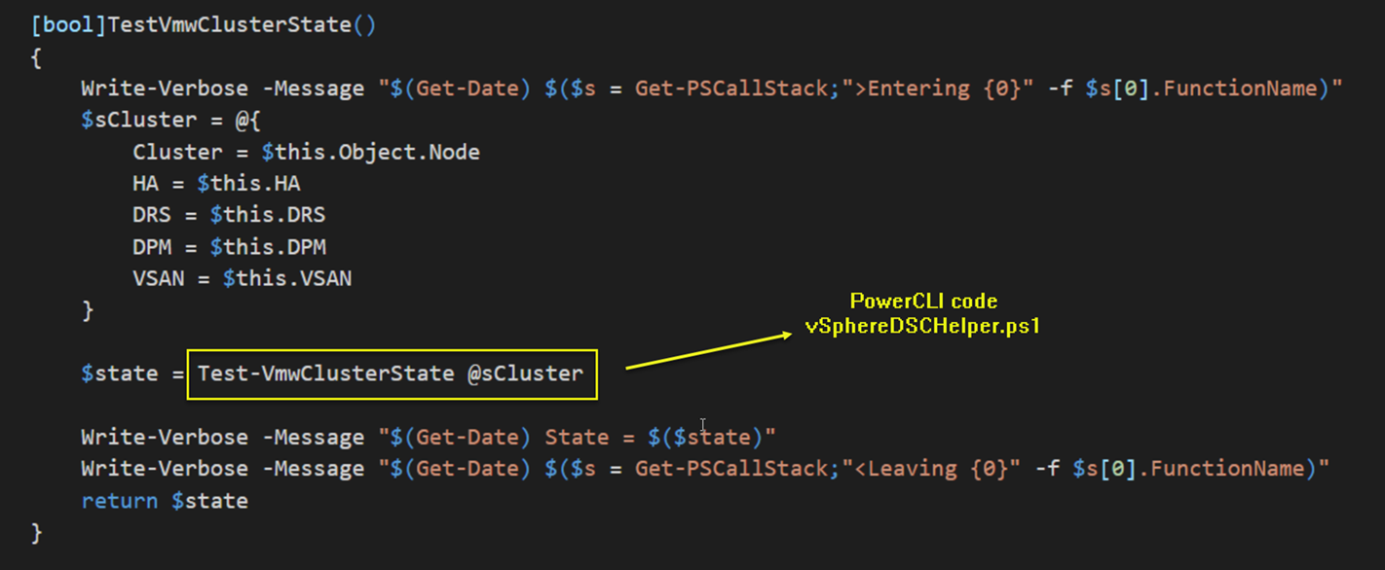
vSphere Aware
Logic beyond DSC functionality. Helper functions
“Knows” about vSphere
PowerShell Conference
Singapore 2017

Slide 19
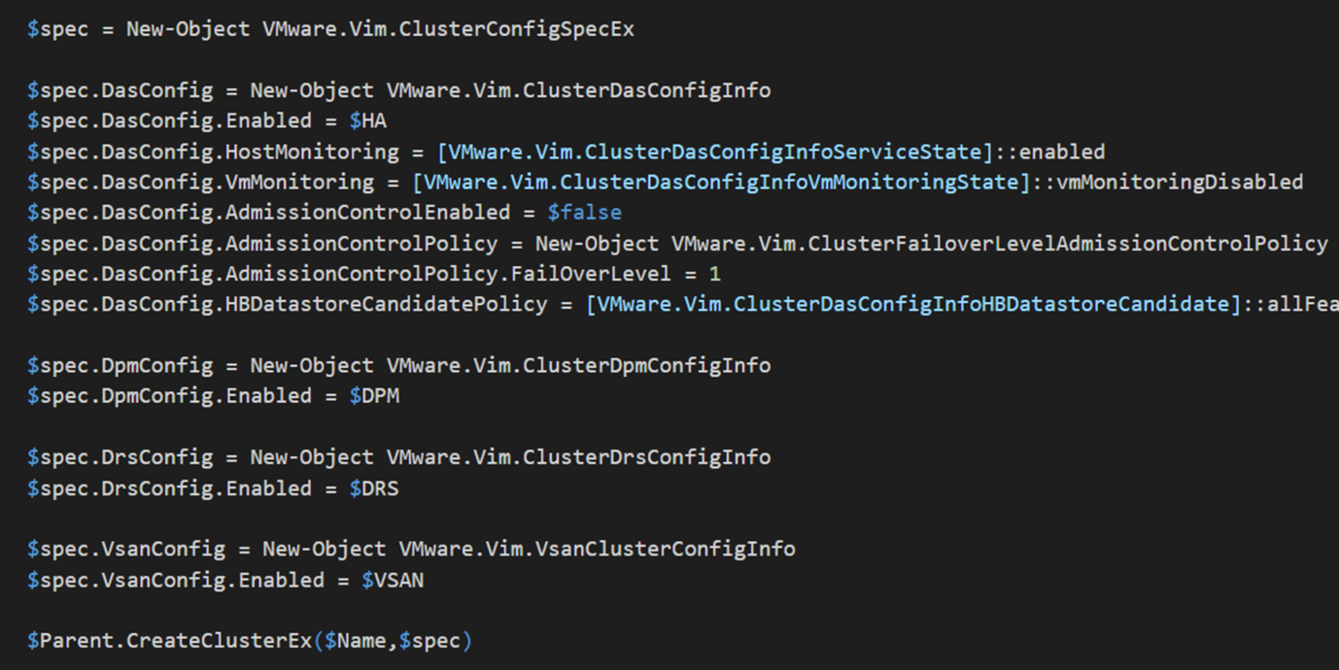
PowerCLI Code
PowerCLI code in vSphereDSCHelper.ps1
PowerShell Conference
Singapore 2017

Slide 20
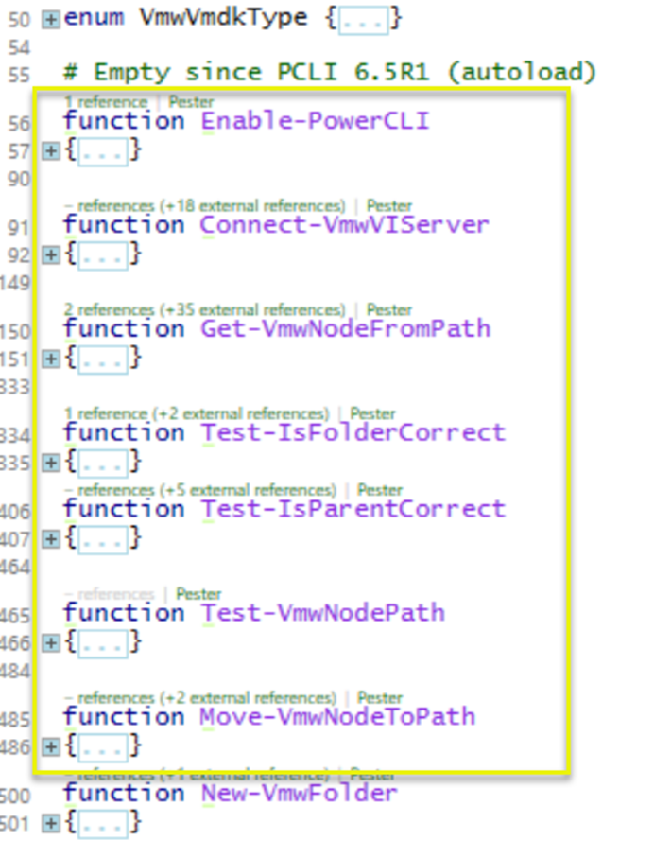
Basic Helper Functions
Basic Helper functions
In vSphereDSCHelper.ps1
Functionality
vSphere server connect
Locate node (test for node + locate parent for new node)
Test if folder is correct
Test if parent is correct
Move a node to a location
PowerShell Conference
Singapore 2017

Slide 21
Adding New Resources
vSphereDSC.psm1
Copy an existing resource
Define class properties (Key & Mandatory!)
Review Get-Set-Test ➔ minimal change
vSphereDSCHelper.ps1
Same set of functions
New/Remove
Test/TestState/SetState
Proto-typing: PowerCLI cmdlets
Production: API methods
PowerShell Conference
Singapore 2017

Slide 22
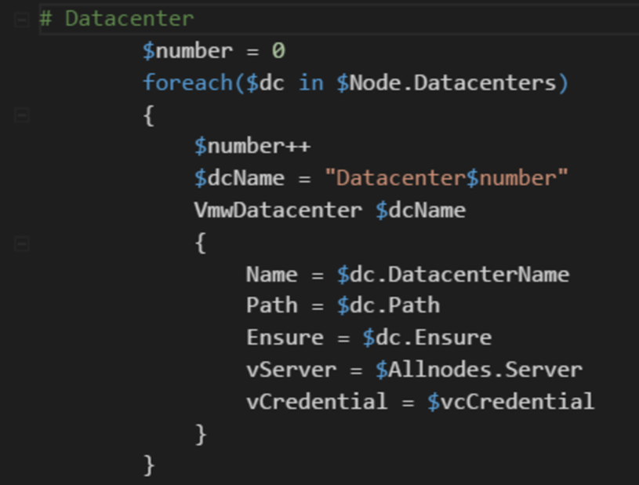
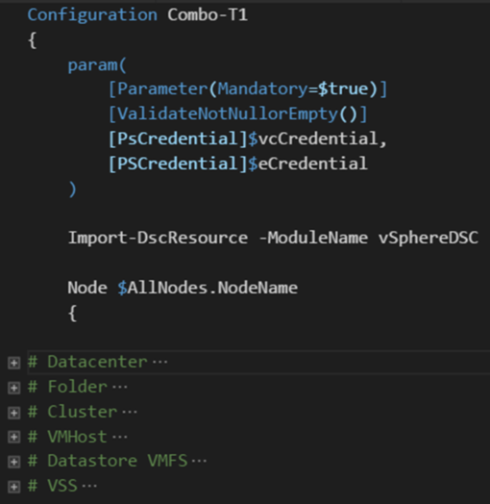
Configuration File
Configuration file
Separate What from Where
Fixed Structural lines
PowerShell Conference
Singapore 2017

Slide 23
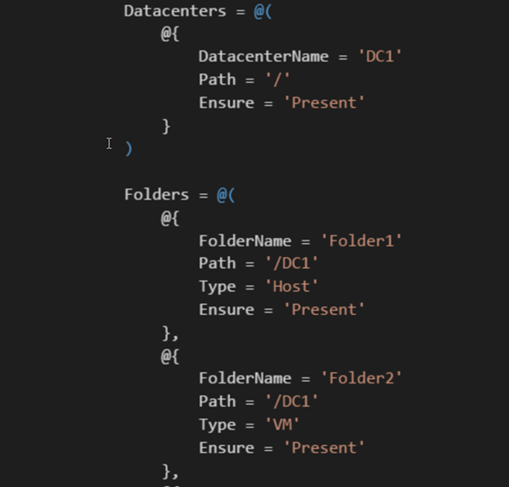
Data File
ConfigurationData in .psd1 file
No variables
Use Configuration parameters
No Enum
Use String
Source control!
Txt file ➔ diff
PowerShell Conference
Singapore 2017

Slide 24
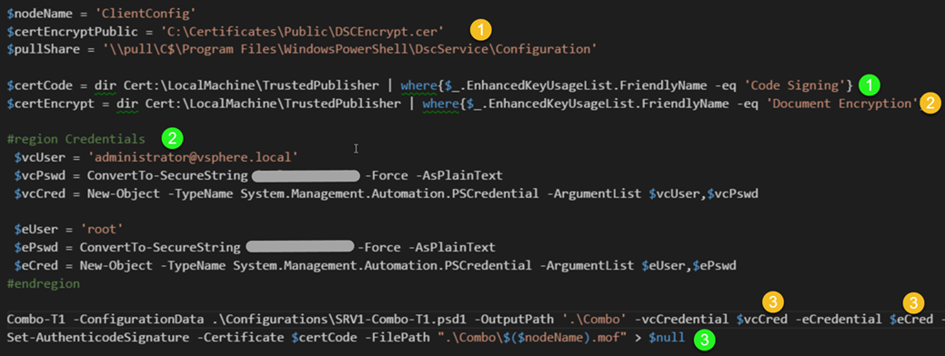
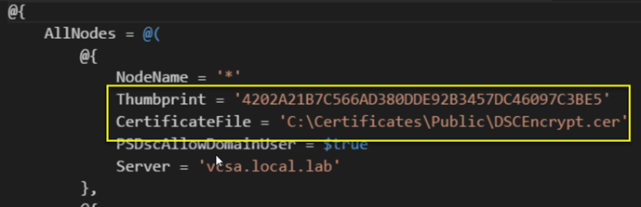
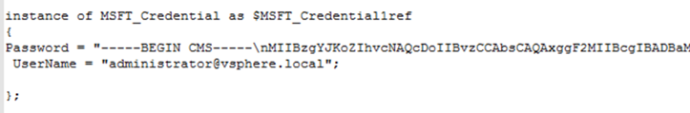
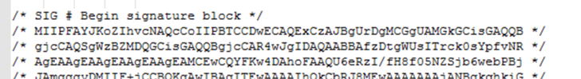
Secure
Security
Configuration signed
Credentials encrypted
PowerShell Conference
Singapore 2017

Slide 25
Reverse
vSphereDSC Resource module allows vSphere configuration through Configuration files
How can we get Configuration files for an existing vSphere environment?
Painstakingly write it out
Automate that process
Why would we need such Configuration files?
SDDC
Diffs
Audit
….
PowerShell Conference
Singapore 2017

Slide 26
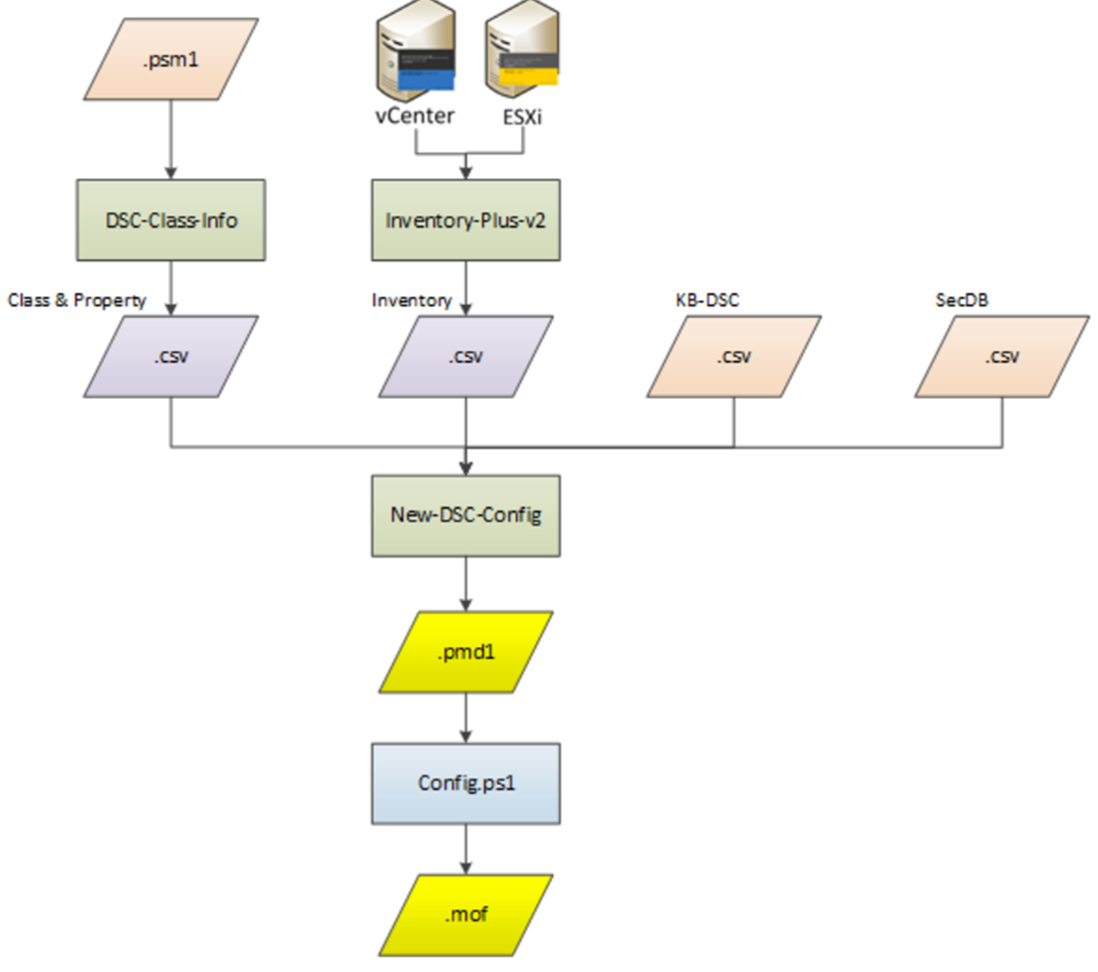
PowerShell Conference
Singapore 2017

Slide 27
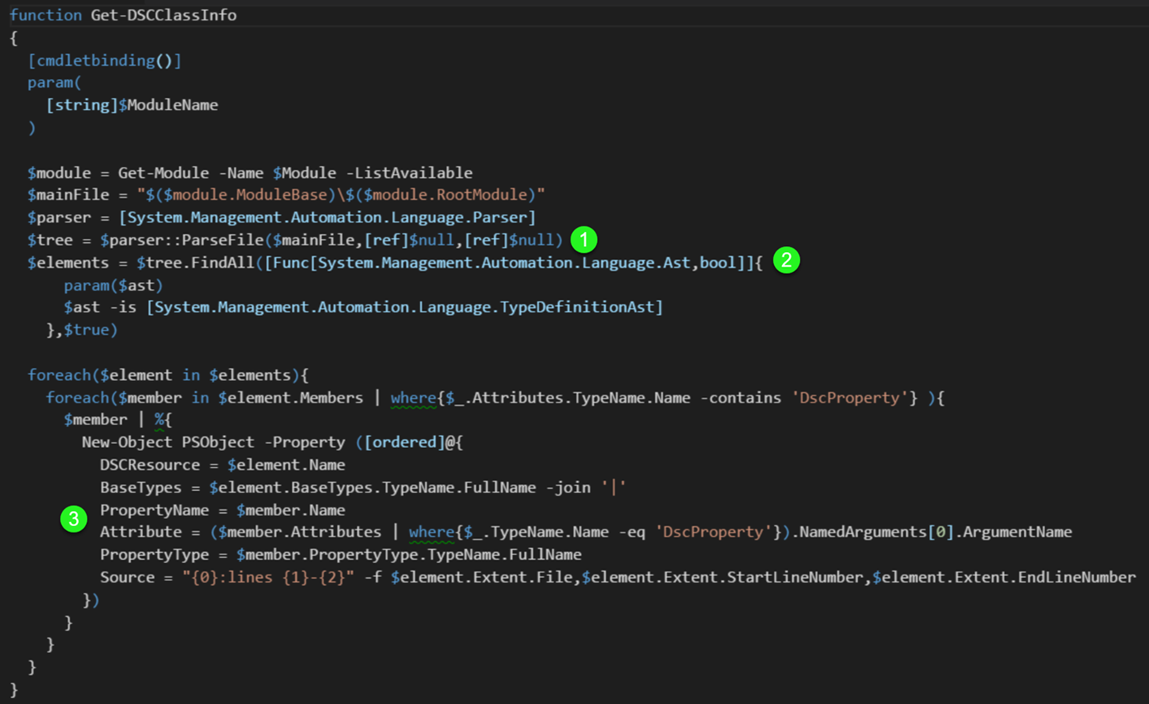
Reading the classes
DSC-Class.Info.ps1
Extracting Class information
Input .psm1 file
Use Abstract Syntax Tree (AST)
PowerShell Conference
Singapore 2017

Slide 28
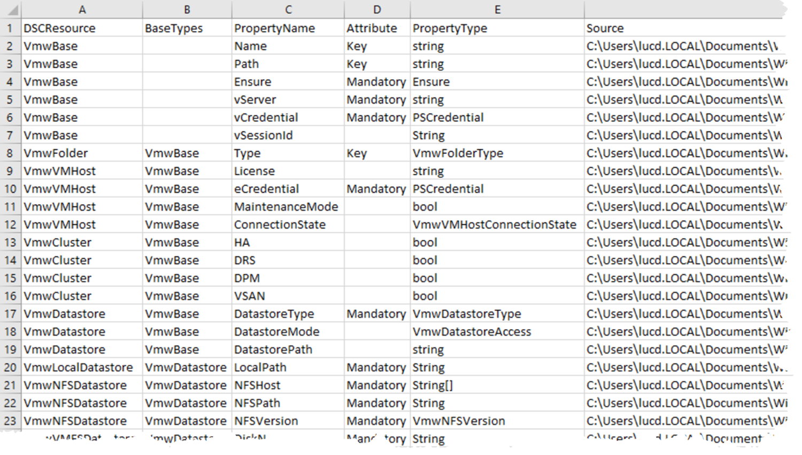
Class Info
PowerShell Conference
Singapore 2017

Slide 29
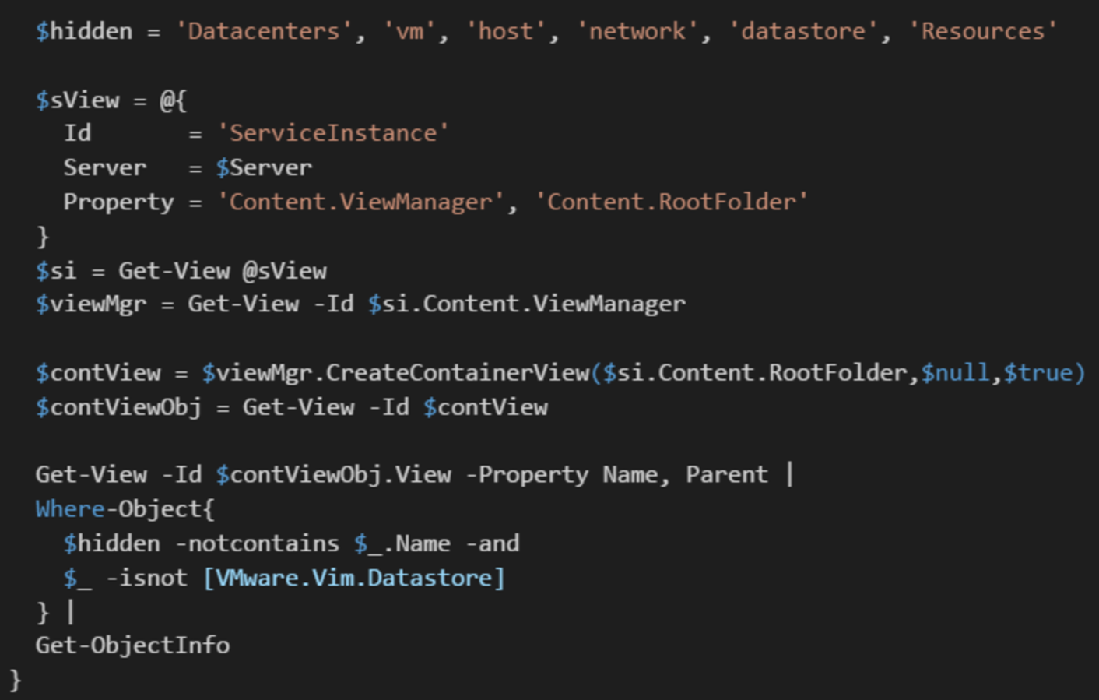
Take Inventory
The Get-Inventory cmdlet does not return all object we want
There is a requirement to see “all” paths for objects
Get-InventoryPlus
Inventory Of All VSphere Objects
PowerShell Conference
Singapore 2017

Slide 30
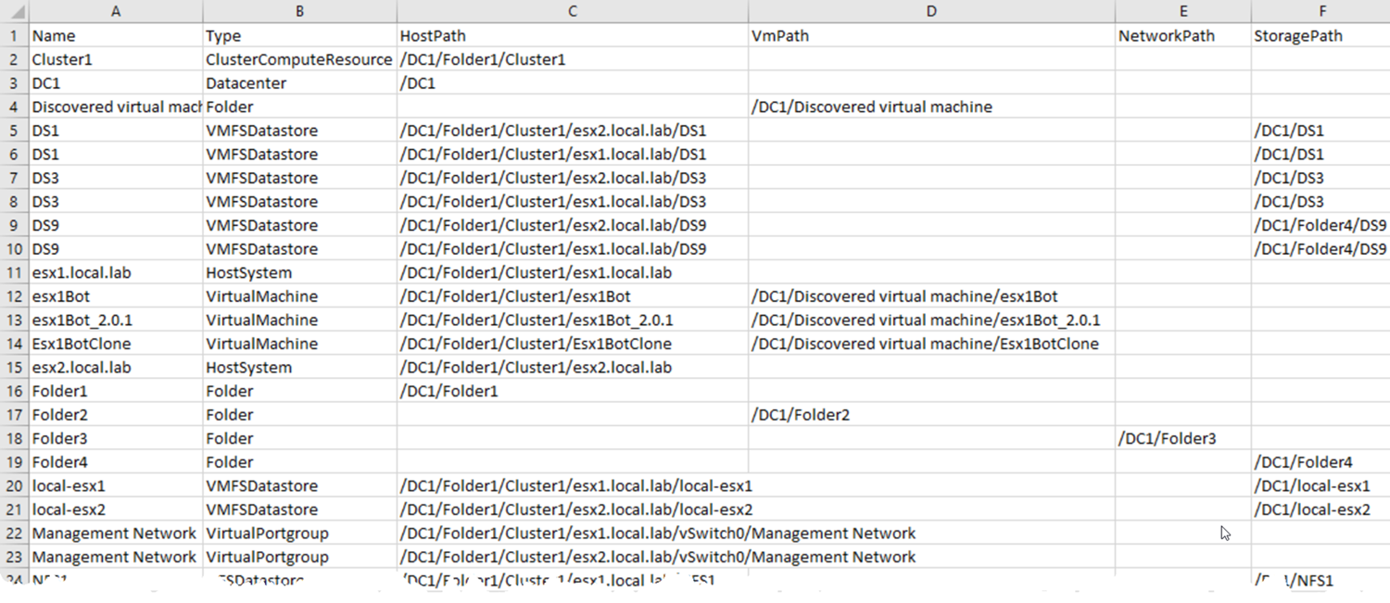
PowerShell Conference
Singapore 2017

Slide 31
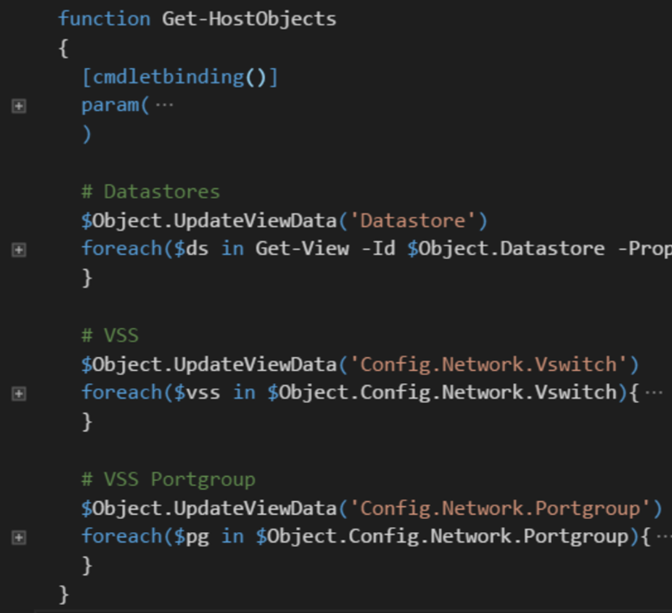
Walk all paths
Some objects only visible through ESXi node!
PowerShell Conference
Singapore 2017

Slide 32
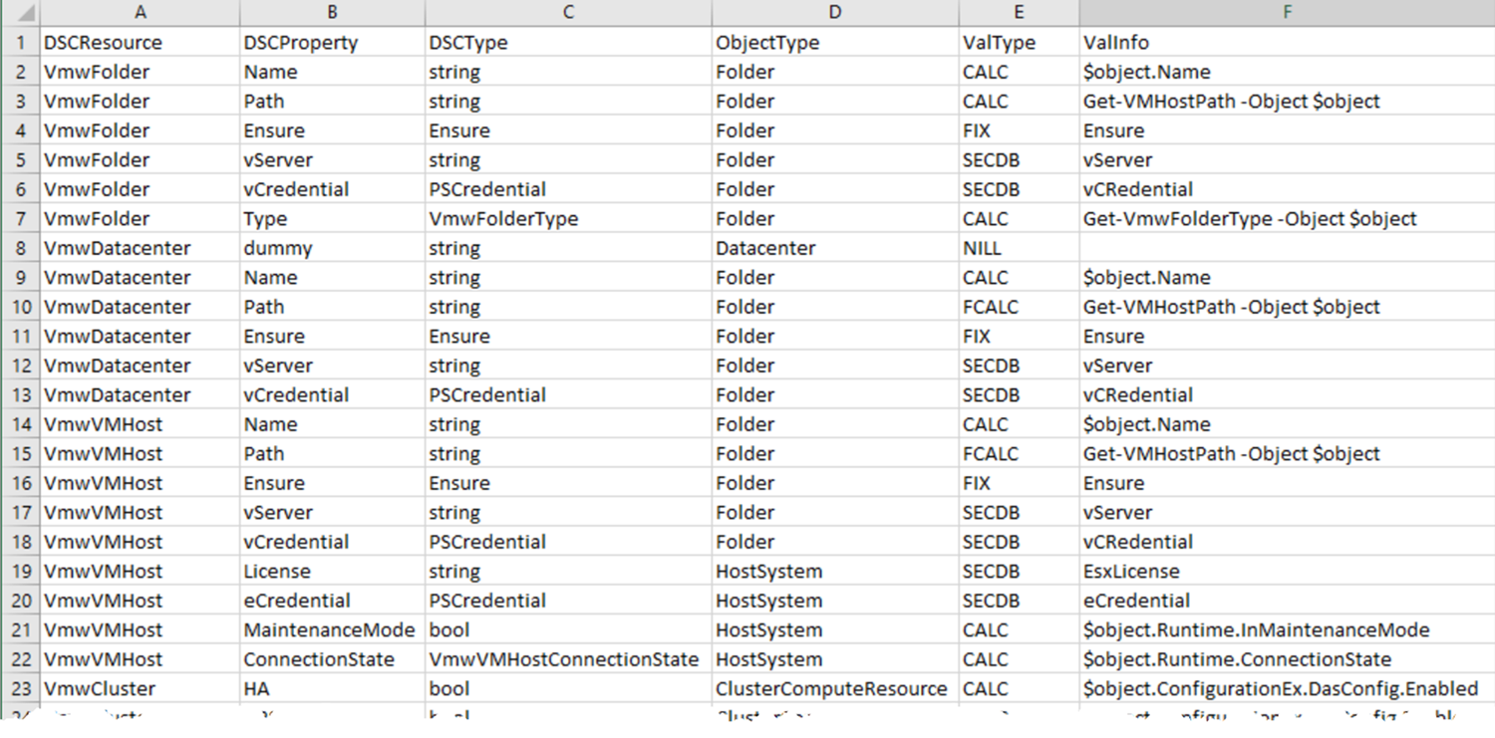
Getting the Values
Configuration data needs the values for the “where” data
This DB contains the formula on how get the value for a class/property
PowerShell Conference
Singapore 2017

Slide 33
Value Formula
The ValType and ValInfo fields indicate how a value can be retrieved
Currently there are following options
FIX: a constant value
CALC: property, the current object is in $object
FCALC: function to calculate the value
SECDB: values that shall be stored secure (under work!)
NIL: entry not needed in ConfigurationData
PowerShell Conference
Singapore 2017

Slide 34
Secure Data
Credentials can not be extracted
Sensitive information (e.g. License keys) in an encrypted DB
Still looking for the better solution
PowerShell Conference
Singapore 2017

Slide 35
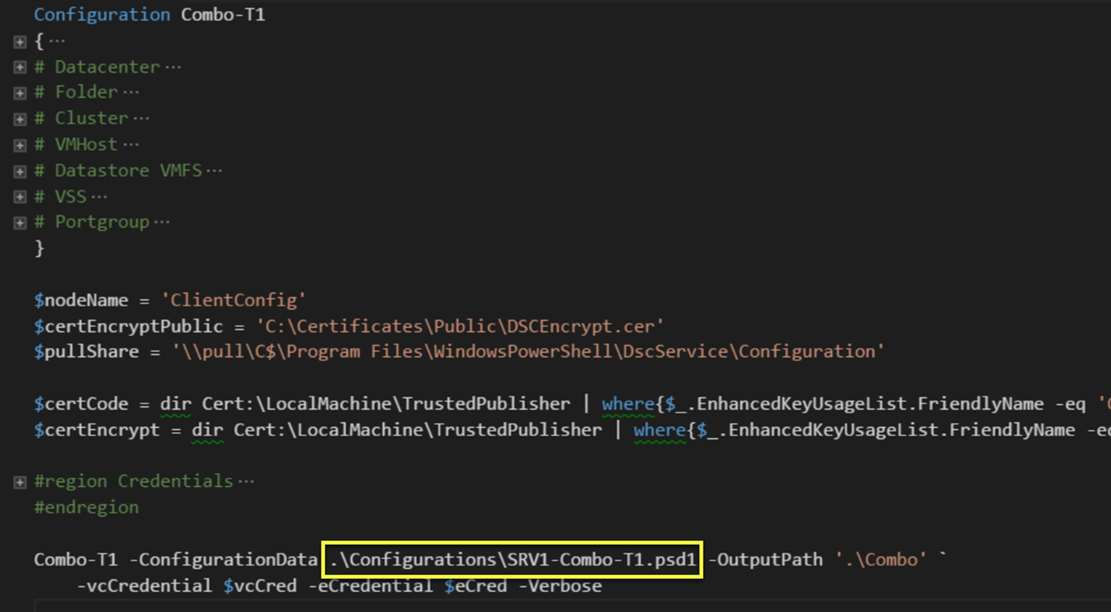
Creating Configuration Data Files
Combines information from the 4 data files
Creates the Configuration data file (.psmd1)
DSC properties are retrieved/calculated via DSCKB entries
PowerShell Conference
Singapore 2017

Slide 36
Use Cases
Current environment to SDDC
Version control
Diffs
Replicate the environment
DRM (see also SDDC)
Lab/GreenField
Migration: full or partial migration of environment
New platform
Upgrade
PowerShell Conference
Singapore 2017

Slide 37
Take Aways
New release –eq New features
Why pick DSC class-based resources
How to handle a target without a LCM
Legacy systems –ne Logical
PowerShell Conference
Singapore 2017

Slide 38

Q&A
PowerShell Conference
Singapore 2017

Slide 39
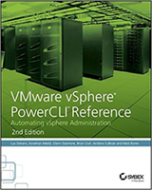

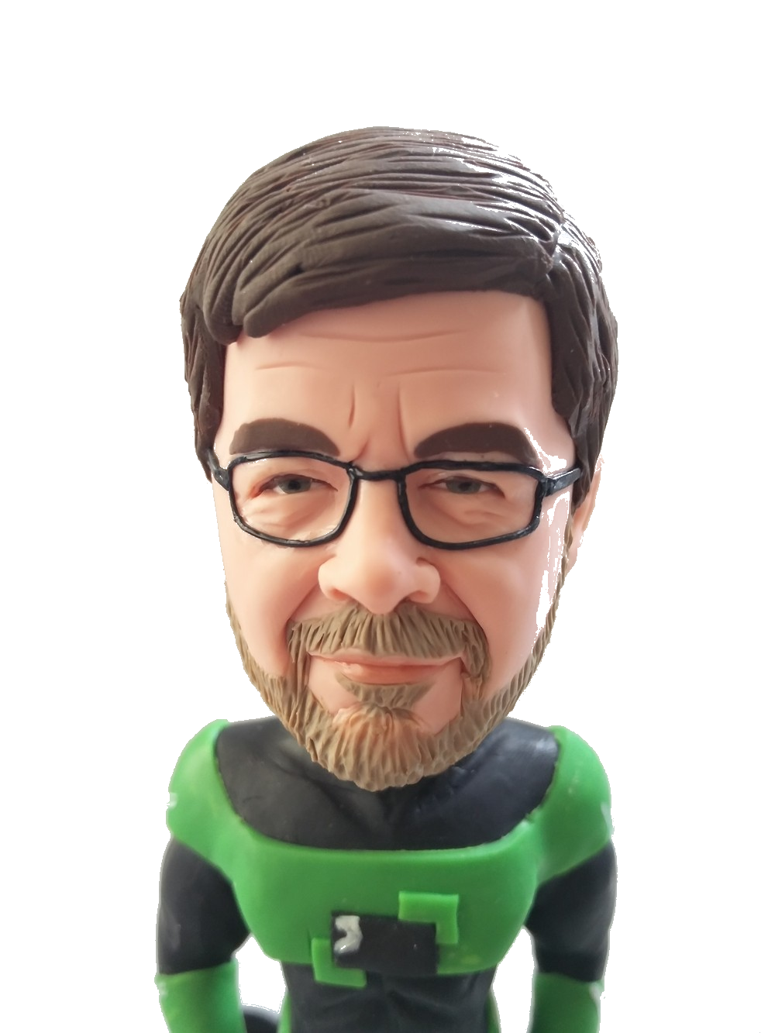
About_Author
Luc Dekens
Belgium (the Flemish part)
Virtualisation ➔ PowerShell/PowerCLI ➔ SDDC ➔ DSC
PowerCLI Reference 1 ed & 2 ed
VMTN Community LucD
Blog LucD.info
Twitter @LucD22
PowerShell Conference
Singapore 2017

Slide 40
Don’t Forget!
Fill in your survey in Mobile app – it’s how we do better!
Don’t lose you badge! You need it for the Social Events
Grab the Speakers for a chat – they all have time for you!
Let everyone know what they are missing on Social Media
#PowerShell
#PSConfAsia
Photos of Marina Bay Credit: Sebastian Szumigalski
PowerShell Conference
Singapore 2017

